Slide 1


Slide 2
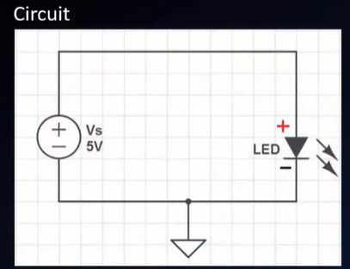
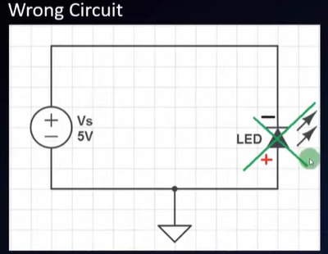
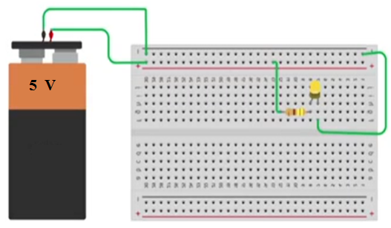
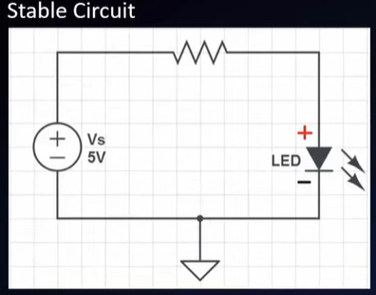
LED + Resistor

Slide 3
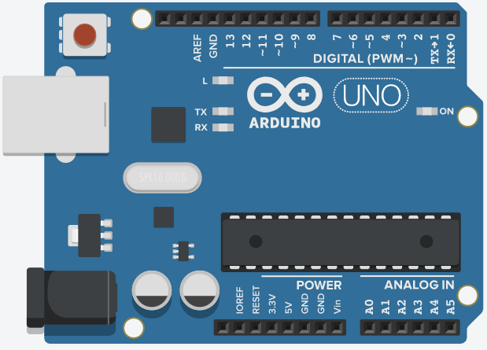


Slide 4
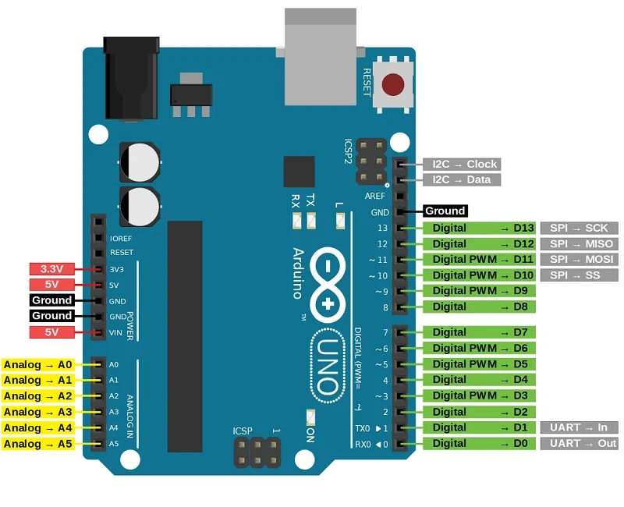
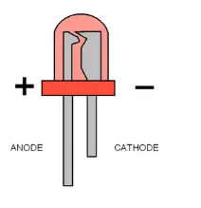


Slide 5
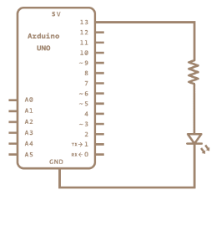
Circuit Diagram
A
K

Slide 6
Apparatus
1.PC with Arduino IDE
2.Arduino UNO Board
3.USB cable
4.LED
5.Bread board
6.1000Ω resistor
7.Jumper wires

Slide 7

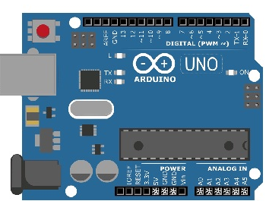

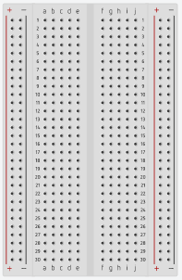
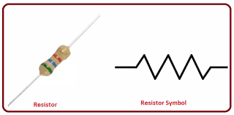
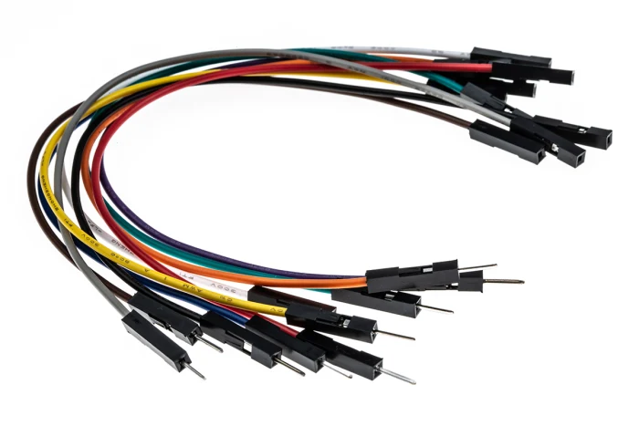
Implementation

Slide 8

Setup - ready ?

Slide 9
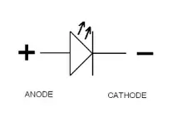
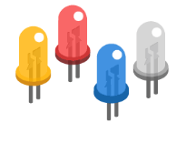
LED

Slide 10
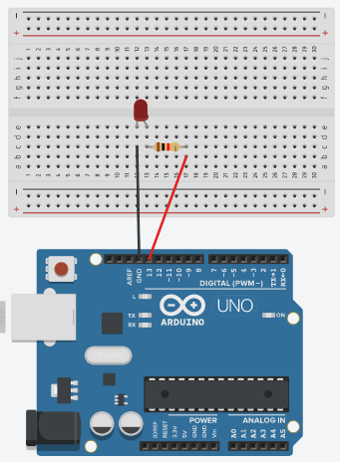

Slide 11
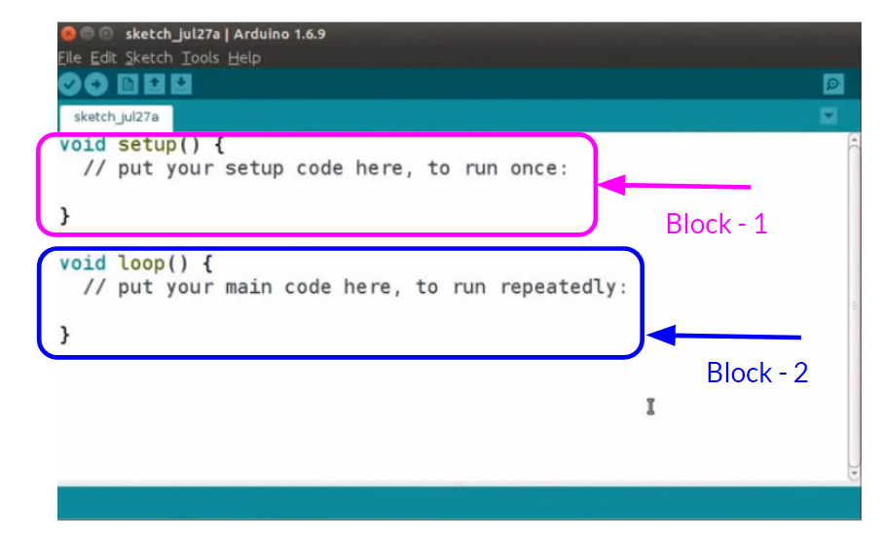
Arudino_sketch

Slide 12
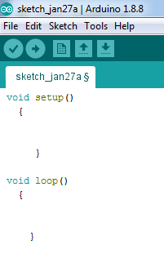
Contd……

Slide 13
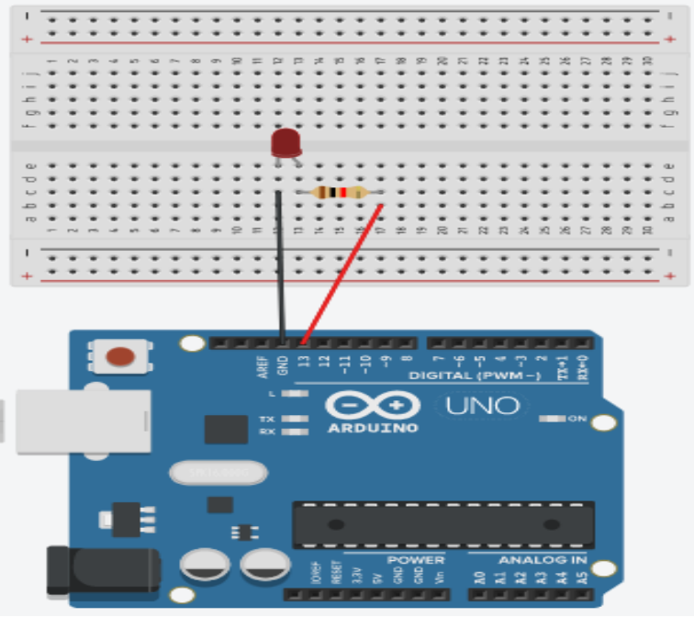
Method-1
LED_BUILTIN = 13
//LED_BLINKING PROGRAM
void setup()
{
pinMode(13, OUTPUT);
}
void loop()
{
digitalWrite(13, HIGH);
delay(500);
digitalWrite(13, LOW);
delay(500);
}

Slide 14
Method-1
//LED_BLINKING PROGRAM
void setup()
{
pinMode(LED_BUILTIN, OUTPUT);
}
void loop()
{
digitalWrite(LED_BUILTIN, HIGH);
delay(500);
digitalWrite(LED_BUILTIN, LOW);
delay(500);
}

Slide 15
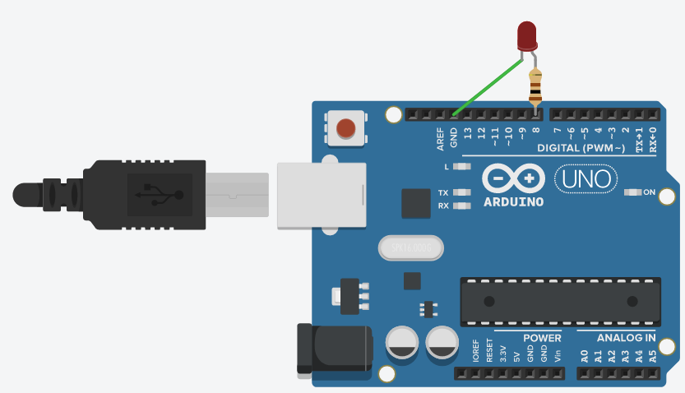
Method-2

Slide 16
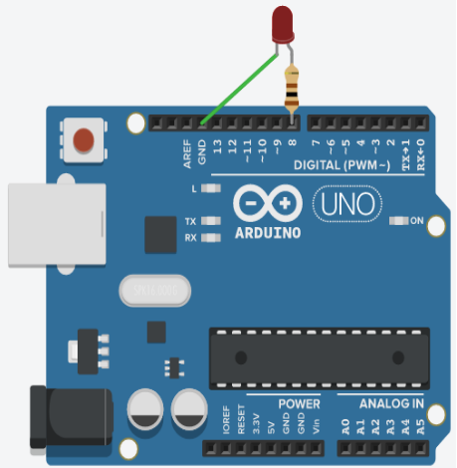
Contd…
//method-2 for BLINKING OF LED
void setup()
{
pinMode(8,OUTPUT);
}
void loop()
{
digitalWrite(8, HIGH);
delay(1000);
digitalWrite(8, LOW);
delay(1000);
}

Slide 17
Method-3
//method-3
// BLINKING OF LED
int ledPin=8;
void setup()
{
pinMode(ledPin,OUTPUT);
}
void loop()
{
digitalWrite(ledPin, HIGH);
delay(1000);
digitalWrite(ledPin, LOW);
delay(1000);
}

Slide 18


Slide 19


Slide 20
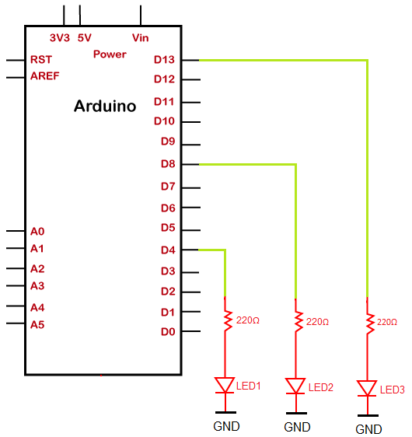
Blinking multiple LEDs using the loop

Slide 21
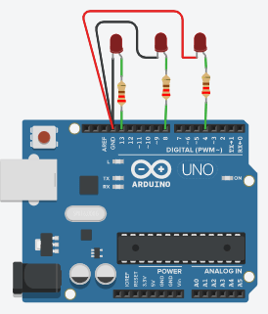
Contd…..
https://www.javatpoint.com/arduino-blinking-multiple-leds-using-loop

Slide 22
code….
//This program blinks LED connection to the pin number 13, 8, and 4
void setup()
{
pinMode(13, OUTPUT);
pinMode(8, OUTPUT);
pinMode(4, OUTPUT);
}
void loop()
{
// the first LED is made to blink one time
digitalWrite(13, HIGH);
delay(1000); // delay time in milliseconds
digitalWrite(13, LOW);
delay(1000);
// the second LED will blink two times
digitalWrite(8, HIGH);
delay(500); // the duration is 0.5 seconds
digitalWrite(8, LOW);
delay(500);
digitalWrite(8, HIGH);
delay(500);
digitalWrite(8, LOW);
delay(500);
// the third LED will blink three times
for( int i = 0; i < 3; i = i +1 )
{
digitalWrite(4, HIGH);
delay(500);
digitalWrite(4, LOW);
delay(500);
// We can adjust the delay time accordingly
}
}

Slide 23
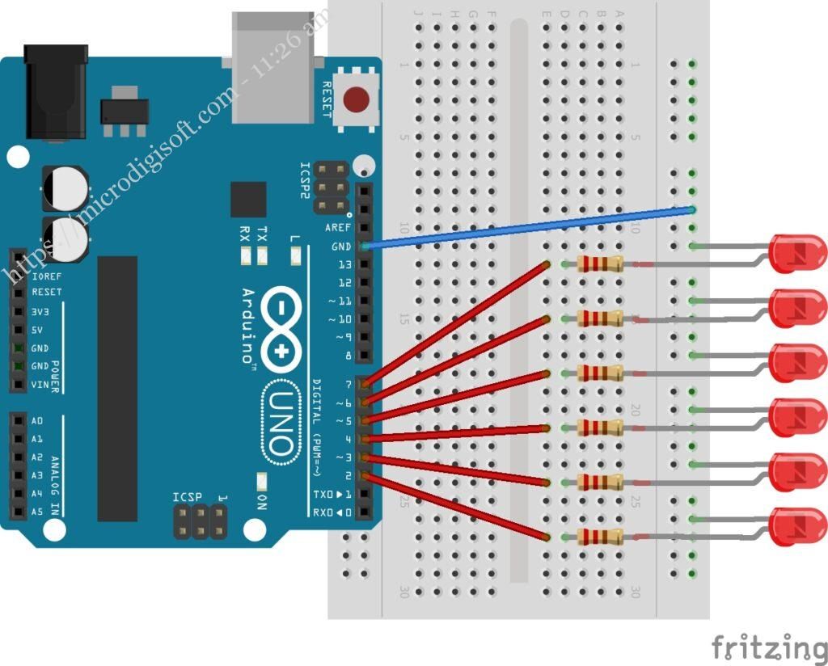
Multiple LED blinking on the Arduino Uno
https://microdigisoft.com/multiple-blinking-led-on-the-arduino/

Slide 24
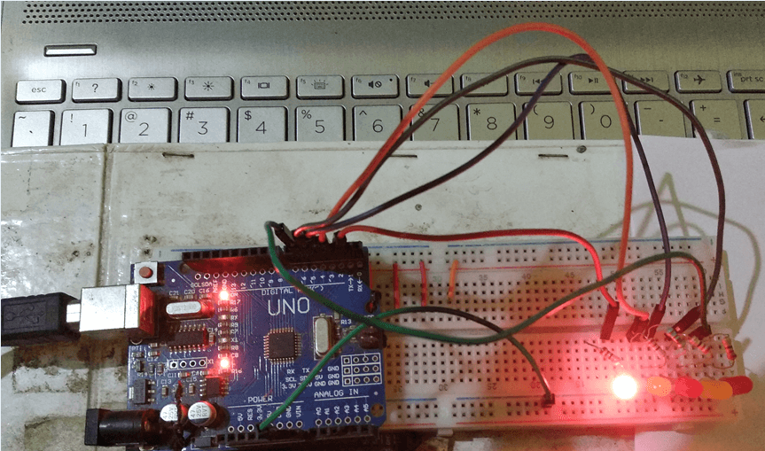

Slide 25
Code….
int ledPins[] = {2,3,4,5,6};
void setup() {
// initialize digital pin LED_BUILTIN as an output.
pinMode(ledPins[0], OUTPUT);
pinMode(ledPins[1], OUTPUT);
pinMode(ledPins[2], OUTPUT);
pinMode(ledPins[3], OUTPUT);
pinMode(ledPins[4], OUTPUT);
}
// the loop function runs over and over again forever
void loop() {
digitalWrite(ledPins[0], HIGH); // turn ON the LED on in ascending
delay(1000);
digitalWrite(ledPins[1], HIGH);
delay(1000);
digitalWrite(ledPins[2], HIGH);
delay(1000);
digitalWrite(ledPins[3], HIGH);
delay(1000);
digitalWrite(ledPins[4], HIGH);
delay(1000);
digitalWrite(ledPins[4], LOW);// turn on the LED in descending
delay(1000);
digitalWrite(ledPins[3], LOW);
delay(1000);
digitalWrite(ledPins[2], LOW);
delay(1000);
digitalWrite(ledPins[1], LOW);
delay(1000);
digitalWrite(ledPins[0], LOW);
delay(1000);// wait for one second
}

Slide 26


